Slide 1
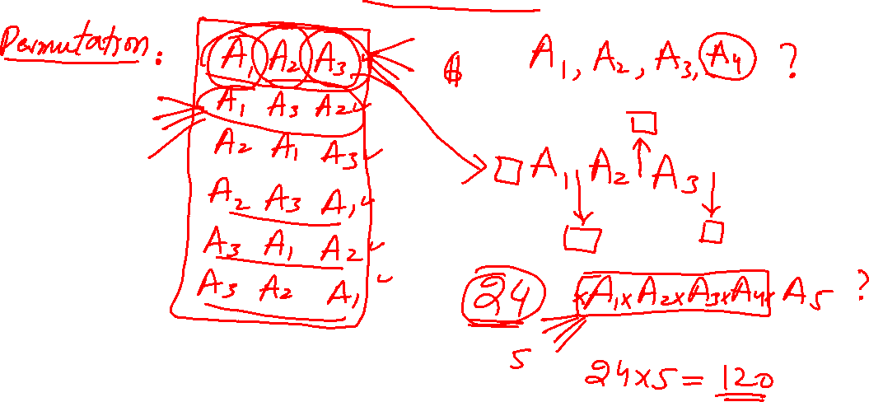
Counting
Notes:
1

Slide 2
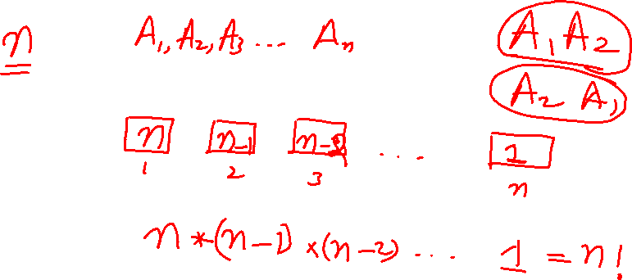
Counting
Notes:
2

Slide 3
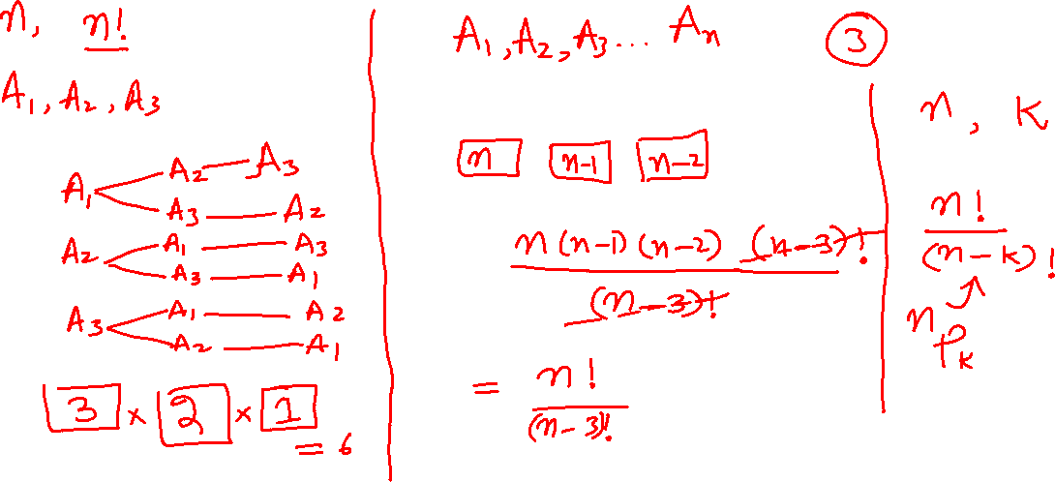
Counting
Notes:
3

Slide 4
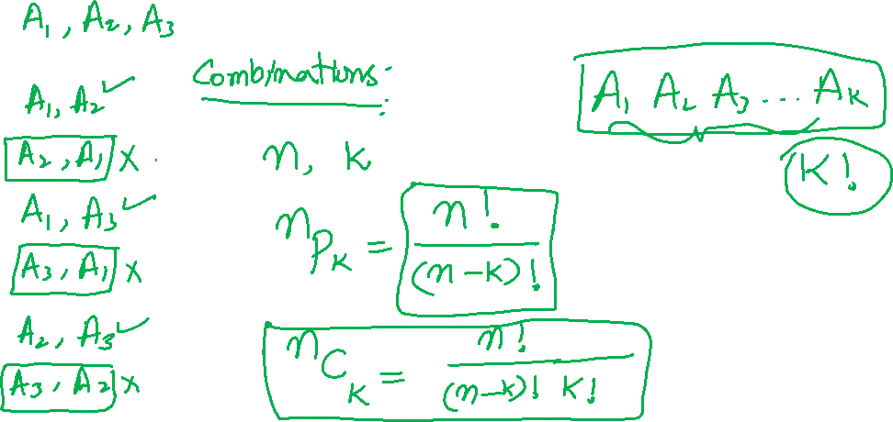
Counting
Notes:
4

Slide 5
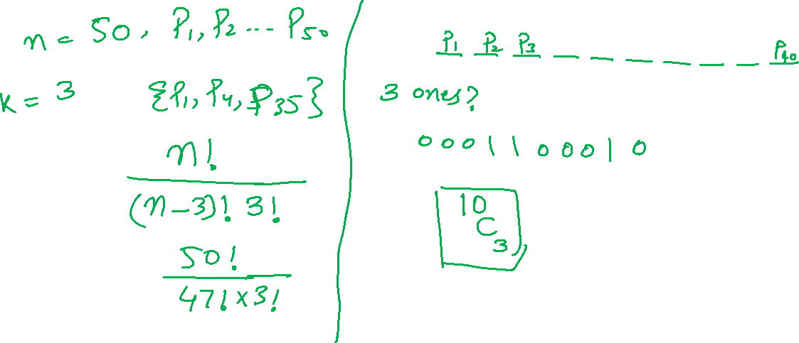
Counting
Notes:
5

Slide 6
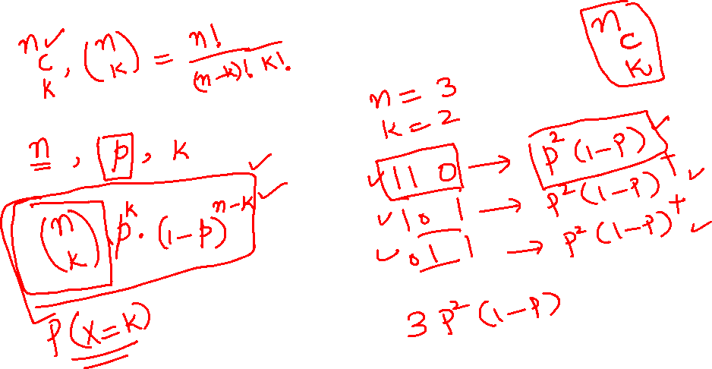
Counting
Notes:
6

Slide 7

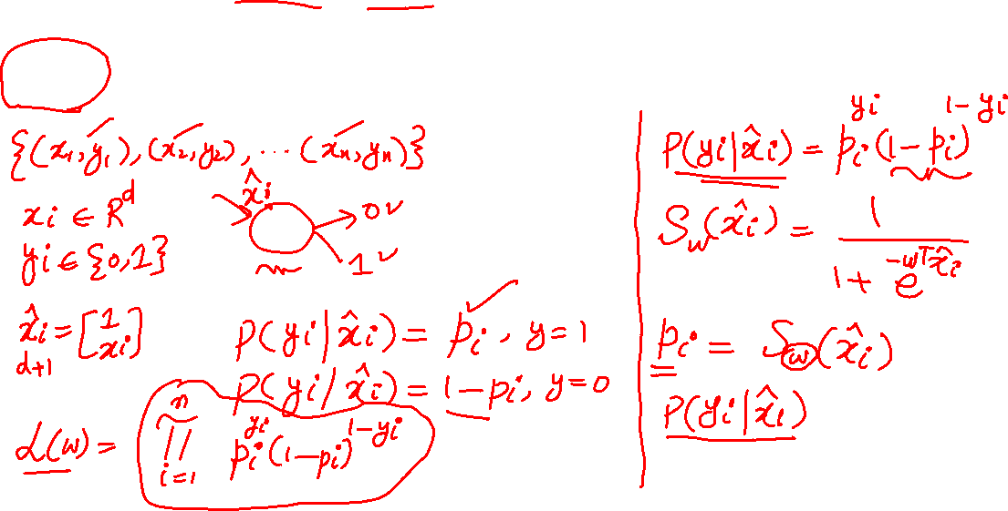
Logistic Regression
MLE on Bernoulli random variables
Notes:
7

Slide 8
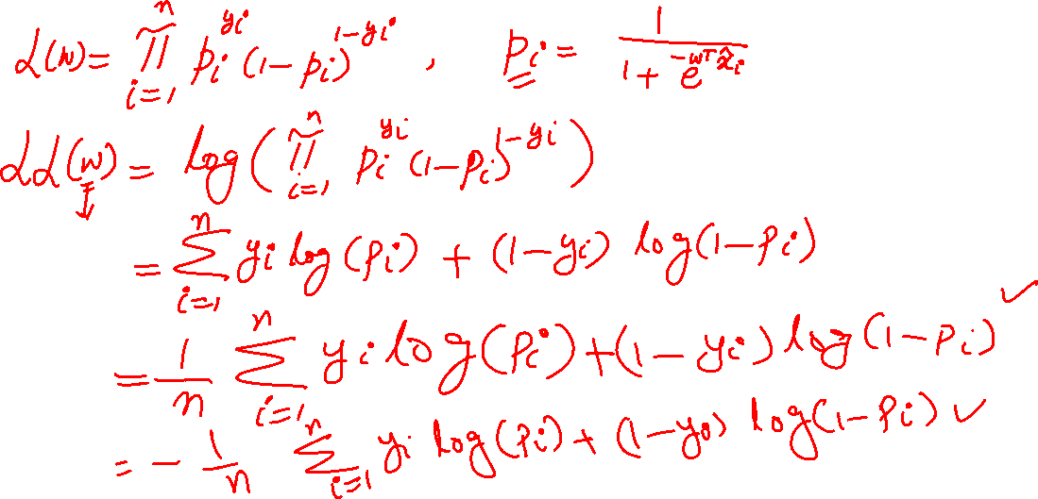
Logistic Regression
Notes:
8

Slide 9
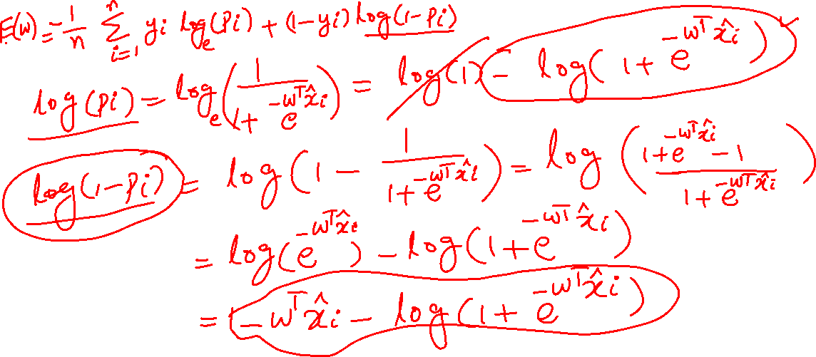
Logistic Regression
Notes:
9

Slide 10
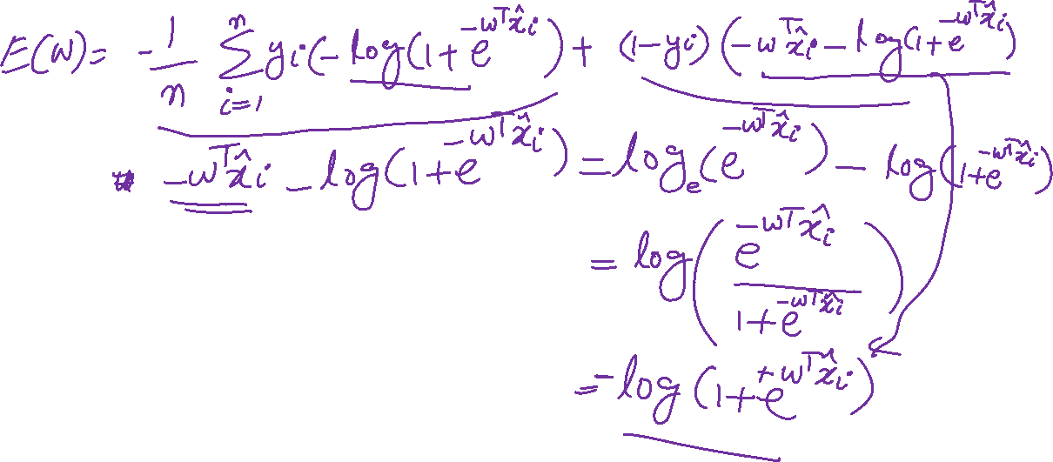
Logistic Regression
Notes:
10

Slide 11
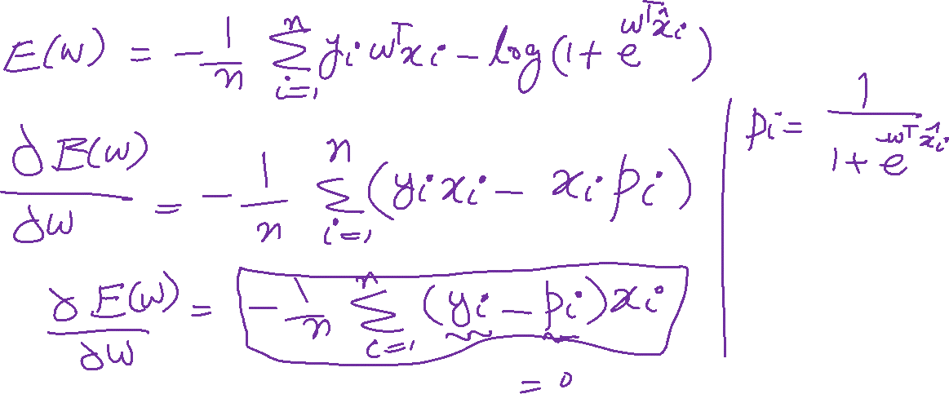
Logistic Regression
Notes:
11

